Slide 1


Breaking Down Your
Website Quality Assessment
PREPARED FOR
[Client Name]
[Month] 2024

Slide 2


What’s in this document?
1
What “website quality” is and why it’s important.
2
What inputs go into the report and how we analyze them.
The outputs of the report and how we use them to execute your campaign.
3

Slide 3
What is “Website Quality”?
Search engines send traffic to websites they deem as “high quality”. That means a few things:
Sites that are coded and structured according to their webmaster guidelines.
Sites that are “popular”, i.e. getting mentioned across the web.
Sites that satisfy “searcher intent” through relevant and quality content.
Having low quality pages, content, poor structure and lack of web mentions causes Google to lose trust in your website and crawl, index and rank it less and less over time.
We assess quality of your website by looking at a number of different data inputs, including inbound links, titles, content depth, sales from organic traffic, keyword rankings and more.
Additional resources:
Google’s Quality Score (Moz)

Slide 4

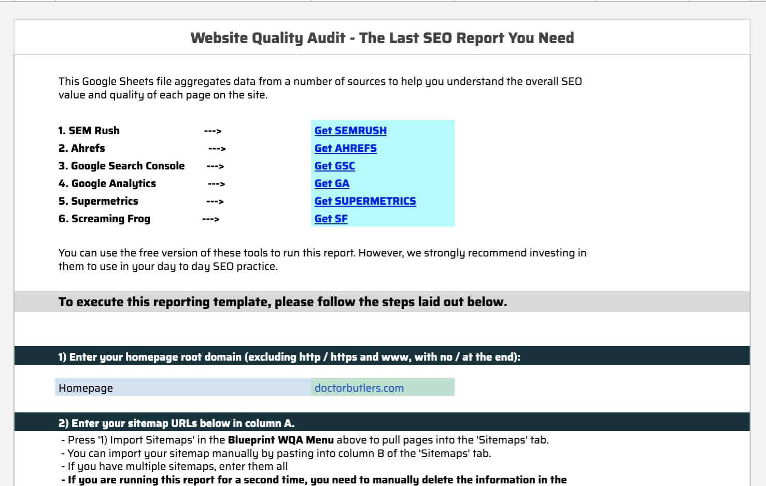
What goes into the “WQA”?
Our team built a tool using API data from 6 vital SEO data sources:
XML sitemaps - to get a list of URLs included in your Sitemap.
Screaming Frog - to get a full list of URLs and files uploaded to your site, page titles, metas, canonical tags and word count per page.
Ahrefs - to get a list of the links pointing to your website and which pages they point to.
SEMRush - to get your current keyword rankings and which pages they correlate to.
Google Analytics - to get sales, leads, and traffic data from search engines only.
Google Search Console - to get SERP impressions and page level click through rates in Google.
Our tool aggregates this data and allows us to assess quality metrics at the page level. From here, we can make a decision about what to do with every page on your site.

Slide 5

What comes out of the “WQA” - Site Sections
Tag | Detail
Product Page | This tag applies to eCommerce websites only. A product page is where they are selling the product (i.e. cart, price, etc).
Product Category | This tag applies to eCommerce websites only. A product category page is where the website lists their products based product type. For example, a website that sells shoes could have category pages for brands like Nike, Reebok, etc. Each of these pages will filter products to show them based on category.
Local Lander | This tag applies to local websites only. A local lander is the dedicated page to a given location. If the business has multiple locations, each store should have it’s own dedicated landing page. If the business only has 1 location, this can apply to the home page.
Lead Generation | This tag applies to pages on a site that are geared towards generating leads. For example, an attorney’s website could be trying to rank for keywords related to the different services they provide (DUI attorney, Criminal defense attorney, etc). Each of these keywords should have a dedicated landing page targeting those keywords.
Blog Post | This tag applies to blog posts. Some sites will have /blog/ or /news/ (or something similar) build into the URL structure.
Blog Category | This tag applies to categories of blog posts. These are generally used on bigger sites that publish a lot of content in order to better organize posts.
Resource / Guide | Similar to a blog post, but more in depth and robust. Resources or guides NOT connected to the blog, but instead are stand alone pages or site sections.
Site Info | This is a broad tag that applies to a wide range of pages. Essentially, these are the required pages to build out a full site but generally have little SEO (i.e. traffic potential) value. This can include about pages, cart pages, terms and services, contact page, shipping, FAQ and more.
After the data is pulled and aggregated, the manual process begins. The first thing we do is group each page into a “section” (see chart for all the section categories we use). We do this for two reasons:
It allows us to segment the site and better prioritize pages / keywords to focus on.
It allows us to compare “apples to apples” (i.e. we don’t want to be comparing an FAQ page to a product page).

Slide 6
What comes out of the “WQA” - URL Actions
URL Action | Detail
1. Leave As Is | No action needed on the page. You can use this tag for pages performing well or for pages you simply want to ignore because they are irrelevant to your SEO (contact page, etc).
2. Update "On Page" | Use this when you want to review the keywords, titles, meta and on page content for that URL. This can also be used for evergreen, cornerstone blog posts / resource guides that you want to update with more recent information. URLs assigned this URL Action are moved into the “KW Research for Existing Pages & On-Page recommendations” deliverable.
3. Target w/ Links | If everything checks out with the page but it doesn’t have rankings, the best solution is to target it with links. You can also double up to “Update On Page” and “Target w/ Links” using both action columns.
4. 301 (Redirect) | When a page serves no value to the website (both for search engines and users) you will want to 301 redirect it into a more relevant page.
5. Canonicalize | If you have similar pages targeting the same topic but you NEED both pages (i.e. you don’t want to remove the page), set a canonical tag that points to the page you want to rank.
6. Block Crawl | If you have a group of pages that serve NO value to search engines (but have value to website visitors), the best option is to block that section from being crawled. This works best when pages are grouped by URL structure (i.e. /archives/).
7. No Index | If you want to stop Google from indexing a low quality page, use this tag. Blocking Crawl is reserved for a number of pages or site sections, No Index is reserved for individual or stand alone pages.
8. Content Analysis | For content (blogs or resources) where there is potential value in updating & optimizing the content for search. URLs assigned this URL Action are moved into the “Content Analysis” deliverable.
9. 410 Delete | If a page no longer serves a purpose to the website, has NO links, NO traffic and the keywords are no longer relevant, we can delete it.
10. Find and Replace URL | If a “301” page is discovered during the crawl, and the internal link can be replaced with its “Final URL” to remove an extra step for crawlers to move through, we want to find that URL and replace it with its final location.
11. Find and Remove URL | If a “404” page is discovered and there is no suitable replacement for the page, we want to find where the broken link is located and remove the link from the site.
After each page on the site is classified into a category, we can quickly assess each page for quality (by section). We assign each page a “URL Action” (see chart to the right for full list and explanations of each). These “URL Actions” dictate:
Which pages to clean up (i.e. redirect, NOINDEX, etc)
Which pages have no potential for traffic and to ignore (i.e. contact page)
Which pages we will focus on for the campaign (i.e. perform KW research, update “on page” elements, target with links).

Slide 7

What are your outcomes?
Important Learnings and Insights:
X 301 URLs and XX 404 links found on the website.
Give the action task to either replace or remove URL.
Very strong backlink profile with 99% of DoFollow links pointed at the homepage (XXX links).
We identified the following items for direct action:
XX pages to Find and Remove the URL
Many of these links are located on this page https://www.gracerosefarm.com/blogs/news/extending-our-season
XX pages to Find and Replace the URL
Many of these links are located on this page: https://www.gracerosefarm.com/blogs/news/getting-to-know-our-customers
XX pages to Optimize On-Page SEO
Product Category pages and important website pages
XX pages to Content Analysis
Blog posts targeting highly search topics
Notes:
Full WQA: https://docs.google.com/spreadsheets/d/14pezrhGWH4xDjQbY4vLyRsrWH3AZpovtBqKRa2laLr8/edit#gid=826597665

Slide 8
What’s next?
Improving existing assets:
URL Actions: Implement technical changes (no index, 301 redirect, etc.)
Keyword Research: Intent mapping for pages marked “Update On Page”
On-Page Recommendations: Improvements (titles, metas, internal links, body text, schema) for pages marked “Update On Page”
Content Audit: Improve and update blog post pages with potential to rank for high volume keywords and to merge pages with very similar content
Creating new assets:
Develop a new system to handle 301’s from discontinued products
Notes:
Full WQA: https://docs.google.com/spreadsheets/d/14pezrhGWH4xDjQbY4vLyRsrWH3AZpovtBqKRa2laLr8/edit#gid=826597665

Slide 9

THANK YOU!
www.propellic.com

